Slide 1
TIERRAROSE
ALL ABOUT ME
And my favorite sports

Slide 2
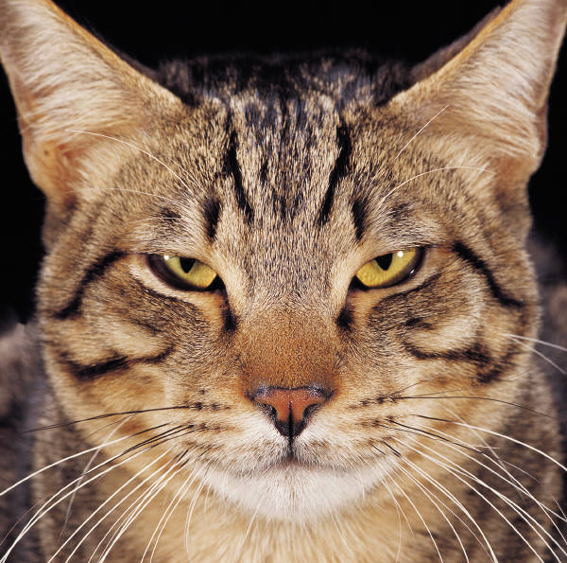
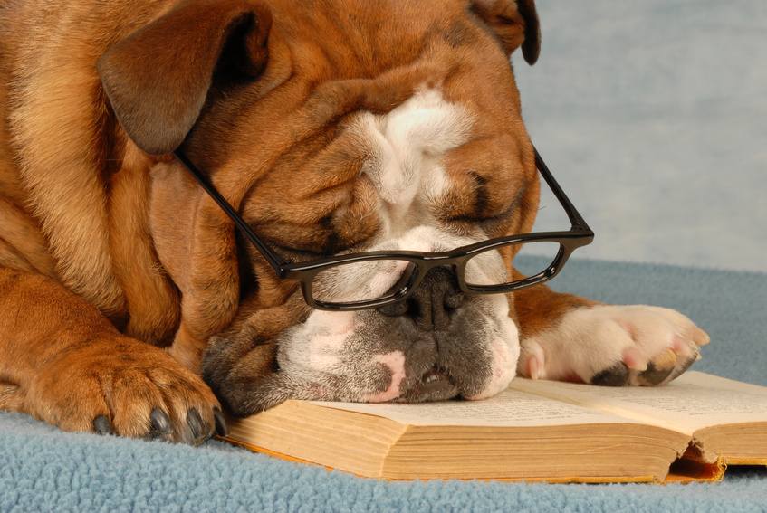
PETS

Slide 3

ALL ABOUT ME
I like to learn in school
And At home I do chores and listen to family
I favorite thing to do is play with my family
I like to read
My faverite sports are basketball,volleyball

Slide 4
favorites
PETS ARE DOGS AND CATS WHAT I LIKE TO DO AT SCHOOL

Slide 6


color

Slide 7
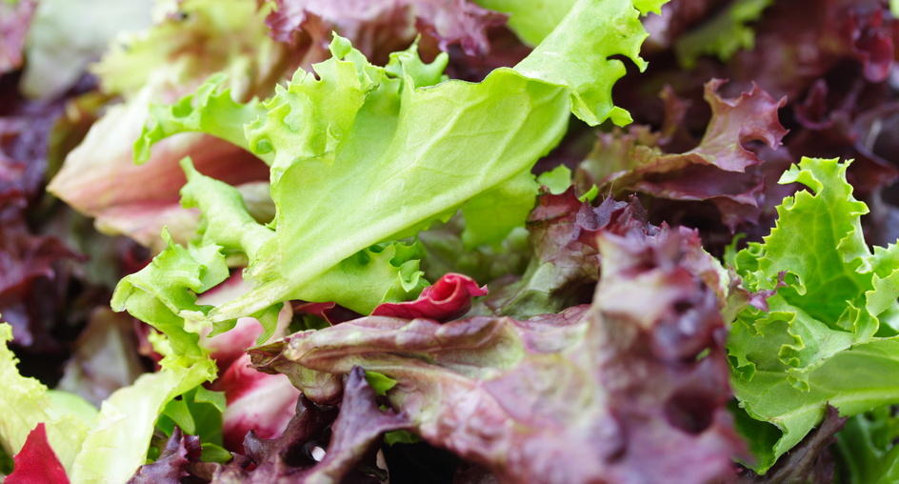
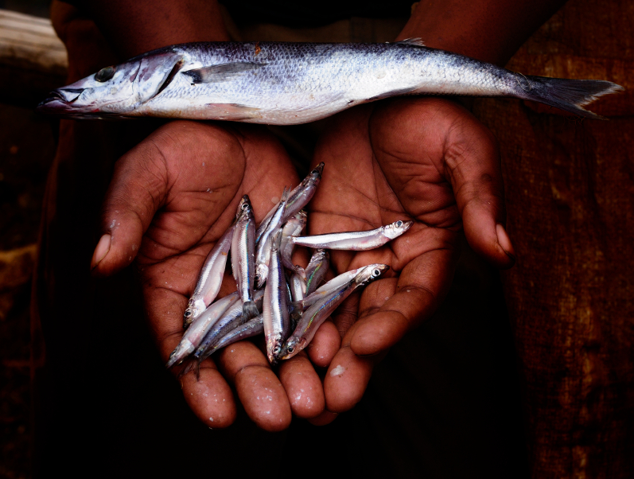
food
Yum!
gross

Slide 8
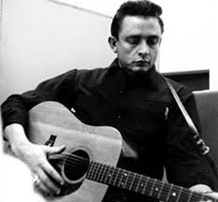
Music

Slide 9
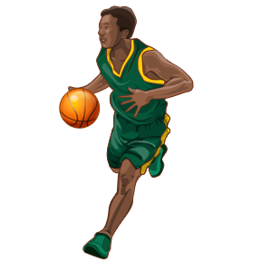
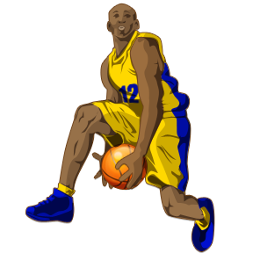
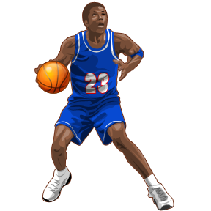
sports

